Slide 1
MCNP Radiation Modeling Plug-in
Isaiah Queen
December 14, 2023

Slide 2
Outline
Introduction
MCNP & VISED
Interface
Using the interface
Outputs
Conclusion

Slide 3

Introduction
Project Goal: Improve abilities to rapidly generate input files for radiation transport models.

Slide 4
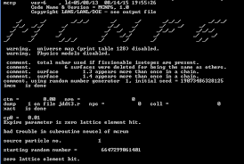
MCNP
Notes:
Here’s an image of the Command Console with MCNP running.

Slide 5
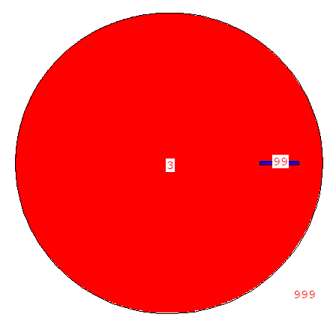
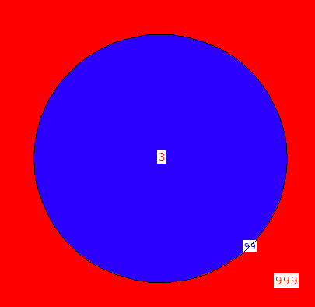
VISED
XZ Radiation Shielding Model
YZ Radiation Shielding Model
Notes:
Here’s an image of an older model of a radiation shield in VISED.

Slide 6
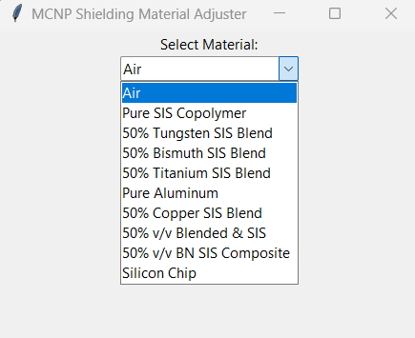
Interface
- Select the Material from the drop-down to produce the input file.

Slide 7
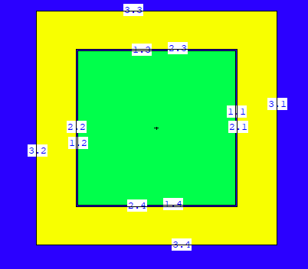
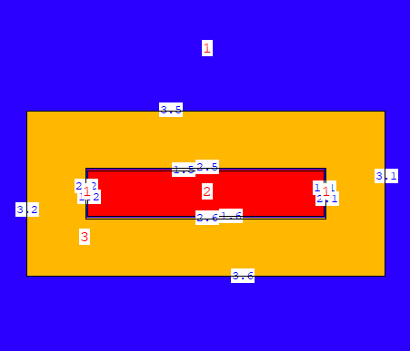
Interface Outputs
XZ Radiation Shielding Model
XY Radiation Shielding Model

Slide 8
Conclusions
Radiation Shielding models critical to development of hardened electronics.
Using this interface will streamline the ability to select different materials to model.

Slide 9
Q & A
DISTRIBUTION STATEMENT C. Distribution authorized to U.S. Government Agencies and their contractors; Critical Technology, export controlled; 11-13 April 2023. Other requests for this document shall be referred to NSWC Crane.

Slide 10
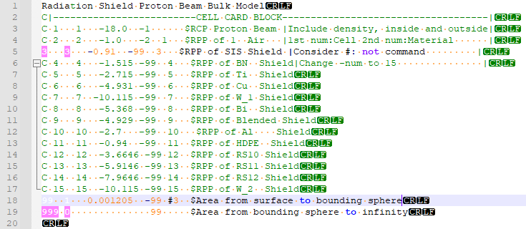
Cell Card

Slide 11
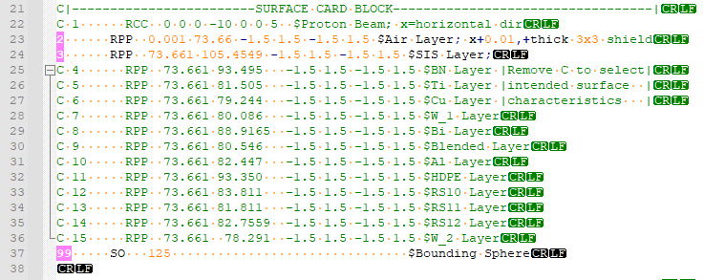
Surface Card

Slide 12
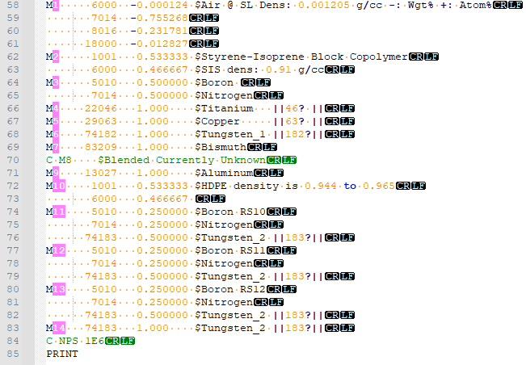
Materials Card

Slide 13
Acknowledgements
Dr. Bradley Duncan
Avery Rosh-Gorsky
Dr. Melissa Smith
Keri Ledford
Paul Miller
Group 81

Slide 14
References
http://www.mcnpvised.com/dontdothat/rotatelatticefail/rotatelatticefail.html

